Slide 1
Advances in Solar Irradiance Forecasting
A Deep Learning Approach

Slide 2
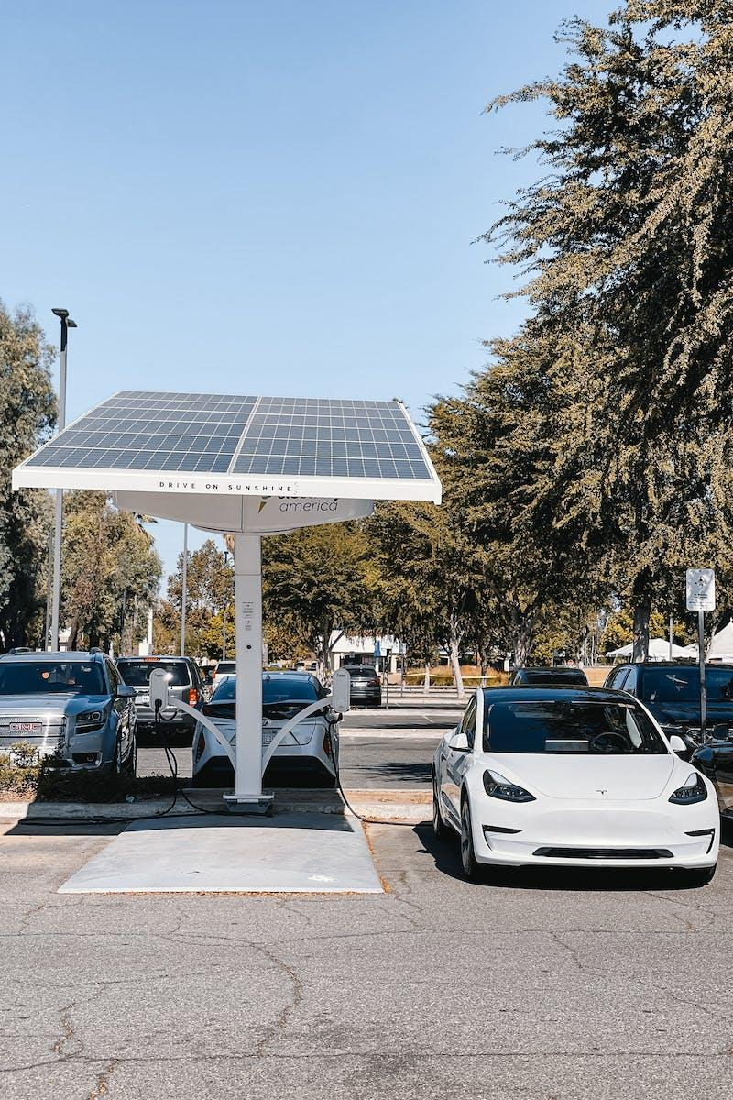
Growing Demand for Solar
Importance of Forecasting
Solar power plants are in high demand due to the need for cleaner energy sources.
Solar irradiance forecasting helps optimize the performance and efficiency of solar power plants.
Accurate forecasting enables better planning and integration of solar power into the grid.
Forecasting also helps in determining the potential of solar energy in specific locations.
Photo by Pexels

Slide 3

Visualizing Solar Irradiance Data
Explore ArcGIS
ArcGIS enables visualizing solar irradiance data with accuracy and clarity.
Interactive maps showcase the distribution of solar irradiance across geographical regions.
Real-time visualization aids in identifying optimal locations for solar energy projects.
ArcGIS offers tools to analyze and compare solar irradiance data for better decision-making.
Photo by Pexels

Slide 4

Accurate Solar Irradiance Prediction
Deep Learning Forecast
Novel deep neural network mechanism
Predicts future solar irradiance
Accurate forecasting of values
Improves renewable energy utilization
Photo by Pexels

Slide 5

Model Architecture
Convolutional & Attention-based LSTM
The proposed model utilizes convolutional layers to extract internal representations from the input data.
This helps in capturing local patterns and features, improving the understanding of the images or sequences.
The attention-based LSTM network further adds the capability to identify temporal dependencies.
This allows the model to focus on specific parts of the input over time, enabling better predictions.
Photo by Pexels

Slide 6

Solar Datasets and Experimental Setup
POWER Project & Deep Learning
The solar datasets used in this study are obtained from NASA's POWER project.
The experimental setup involves comparing different deep learning models.
The deep learning models are trained on the solar datasets for performance evaluation.
Different metrics such as accuracy, precision, and recall are used for comparison.
Photo by Pexels

Slide 7
Forecast Performance Analysis
Positive Findings
Limitations
The proposed model achieved a high R2 score, indicating a strong correlation between the predicted and actual values.
Bias in the model's predictions was significantly reduced, leading to more accurate forecasts.
The model exhibited low variance, suggesting consistent performance across different datasets.
One limitation of the model is its inability to capture certain complex patterns, resulting in some inaccuracies.
The model's performance might be sensitive to outliers, potentially affecting the reliability of predictions.
The analysis did not account for potential changes in future data distribution, which could impact the model's performance.

Slide 8

Conclusion
Superior Performance
The study's findings have shown impressive results.
The proposed model outperformed all other models tested.
The accuracy of the proposed model was consistently high.
Multiple experiments confirmed the superior performance.
Photo by Pexels

Slide 9
Improving Forecast Performance
One key factor contributing to improved forecast performance is the use of advanced machine learning algorithms.
1
Additionally, incorporating real-time data and external factors such as weather patterns and consumer trends can significantly enhance forecasts.
2
Furthermore, implementing a robust data cleansing and validation process ensures the accuracy and reliability of forecast outputs.
3

Slide 10

Future Research in Solar Irradiance Forecasting
Advancements & Potential
Improved models for long-term solar irradiance prediction can contribute to better energy planning and grid integration.
Analysis of different machine learning algorithms can help identify the most accurate and efficient forecasting techniques.
Exploring the impact of weather patterns and climate change on solar irradiance can enhance the accuracy of predictions.
Integration of satellite data and ground-based sensors can improve real-time solar irradiance forecasting.
Photo by Pexels

